Slide 1
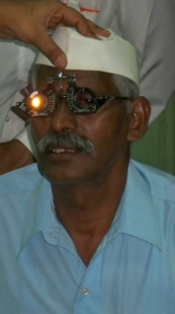
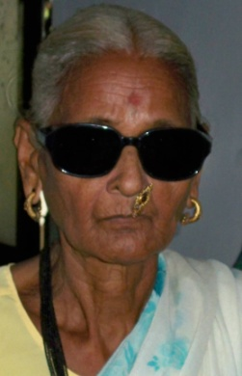
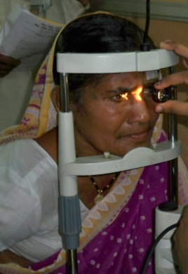
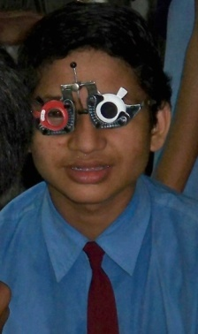
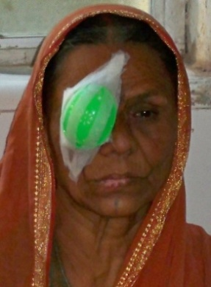
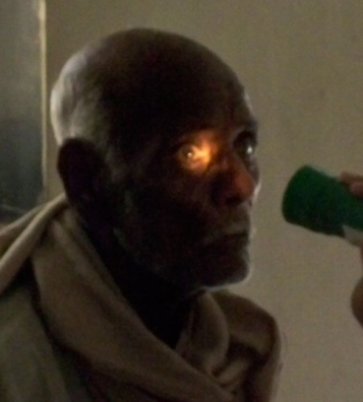
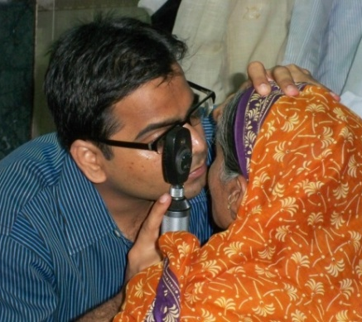
Free Ophthalmic Hospitals’ Society
KBHB Charitable Ophthalmic & ENT Hospital, Parel, Mumbai

Slide 2
Blindness: Global Facts by WHO
285 million visually impaired people
An estimated 120 million are visually impaired because of uncorrected refractive errors (glasses)
90% of visually impaired people live in low- and middle-income countries
An estimated 82 % of all people with blindness are over 50 years old
28% of people living with moderate and severe visual impairment are in their working years
Up to 80% of visual impairment and blindness in adults is preventable or treatable
Around 1.4 million children are blind

Slide 3
Blindness: Indian Facts by -
One out of every three blind people in the world lives in India - an estimated 15 million blind people live in India.
Every year, 3 million people develop cataracts in their eyes, which is leading cause of blindness (62.6%)
More than two thirds of India’s visually handicapped live in Andhra Pradesh, Orissa, Madhya Pradesh, Maharashtra, Rajasthan, Tamil Nadu and Uttar Pradesh
A largely undocumented cause for blindness in India is diabetic retinopathy especially in the working middleclass.

Slide 4
Cont… Blindness: Indian Facts by
According to the National Health Policy document of the Government of India, 1983, “One of the basic human rights is the right to see”.
Despite this lofty aim, India’s blind population totals a whopping 12 million.
Other causes are glaucoma, macular degeneration, posterior segment pathology, retinal detachment, corneal opacities, retinitis pigmentosa, and surgical complications.
The National Programme for Control of Blindness, launched in 1976, aims to reduce the overall blindness prevalence rate from 14 blind persons per 1000 population to 3.

Slide 5
Magnitude of the Problem of Blindness
Low prevalence
(<1%)
Punjab, Himachal Pradesh
Delhi, West Bengal & North Eastern states
Moderate prevalence
(1 to 1. 49 %)
Gujarat, Haryana, Kerala, Assam,
Karnataka, Andhra Pradesh & Bihar
High prevalence
(1.5 to 1.99 %)
Maharashtra, Orissa
Tamilnadu and Uttar Pradesh
Very high prevalence (2 % and above)
Madhya Pradesh
Rajashtan & Jammu & kashmir
Ref - Health and Population - Perspectives and Issues 24(2): 99 - 108, 2001

Slide 6
Blindness Scenario in India
Estimated blind persons 15 million
Causes of Blindness
In adults, over age 50
Cataract 62.6%
Refractive Error 19.7%
Glaucoma 05.8%
Posterior segment disorder 04.7%
Corneal opacity 00.9%
Others 06.2%
In Children
Refractive Error 33.3%
Congenital Eye anomalies 25.0%
Retinal degeneration 16.7%
Vitamin A deficiency 08.3%
Others 16.6%

Slide 7
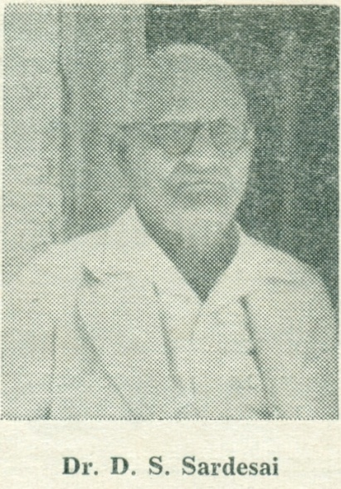
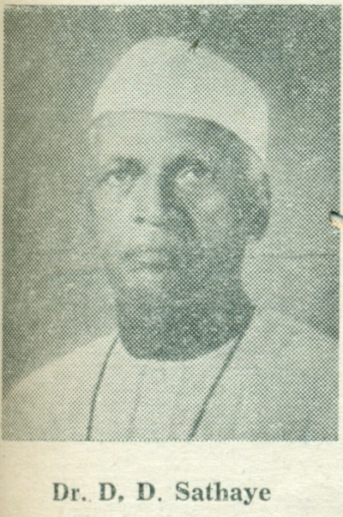
Free Ophthalmic Hospitals’ Society – About Us
Founded in 1914
Founders –
Three eminent Ophthalmologists (eye specialist)
Dr. Sathaye
Dr. Sardesai
Dr. Athwale

Slide 8
Our Mission and Objectives
Aim –
To become a “Centre of Excellence” & “To Play a Major Role in reduction of needless Blindness in State of Maharashtra
Objectives of the Society –
To give free or on payment medical and surgical treatment to persons suffering from eye diseases of eye and ENT
To provide teaching facilities for the students of post graduate in ophthalmology and ENT, Nurses and opticians
To provide facilities for research work in Ophthalmology

Slide 9
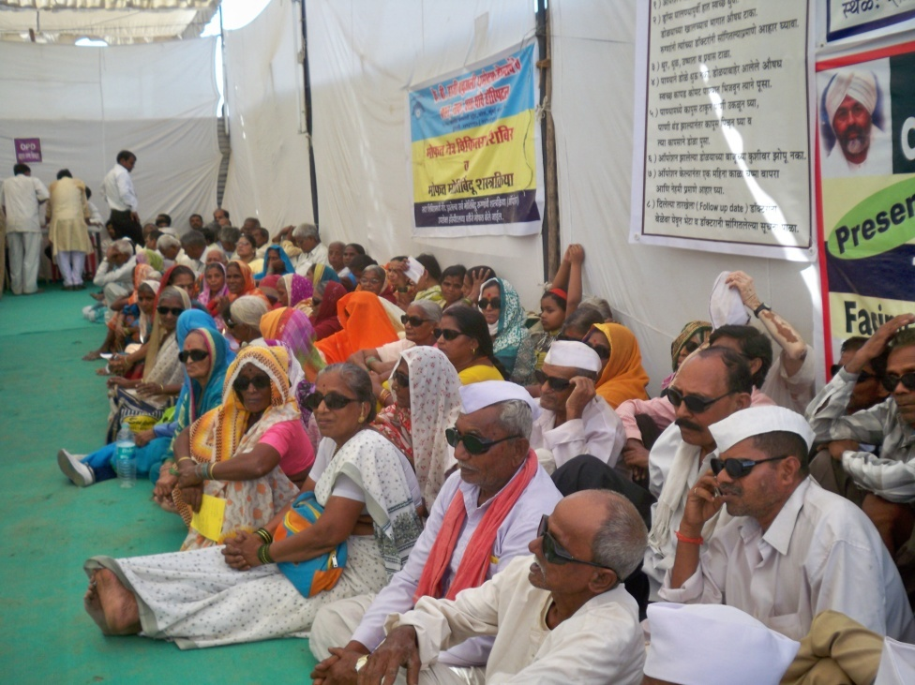
Important Milestones
On 8th August 1932 Father of Nation “Mahatma Gandhi” laid the foundation stone of KBHB Charitable Ophthalmic & ENT Hospital, in Parel, Mumbai.
In 1997 Community Outreach Department started in the hospital. With the objective of “Reached to unreached”

Slide 10
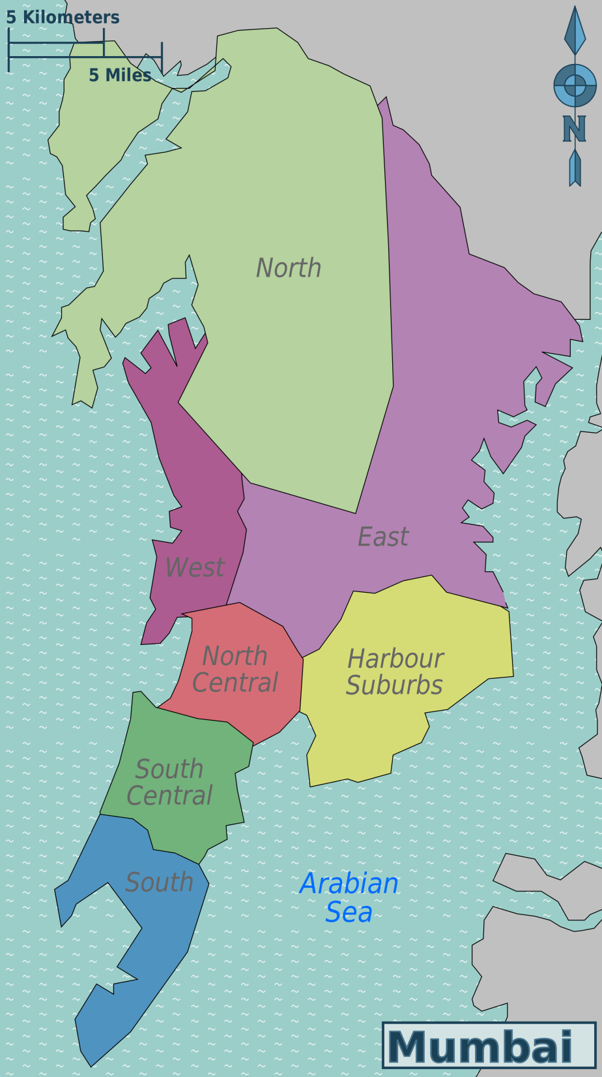
Our Reach in Mumbai
Yearly more than 120 camps organized in various slum pockets of Mumbai
8 fully equipped and furnished Vision Center
1 fully equipped ophthalmic Mobile Van
Network of more than 100 NGOs
Caters its services to more than 4 lakhs of population in Mumbai and suburban
Daily 500 OPD in the Hospital
Yearly more than 10000 eye surgeries performed from which 60% of Free and remaining are at affordable prize
KBHB Hospital

Slide 11
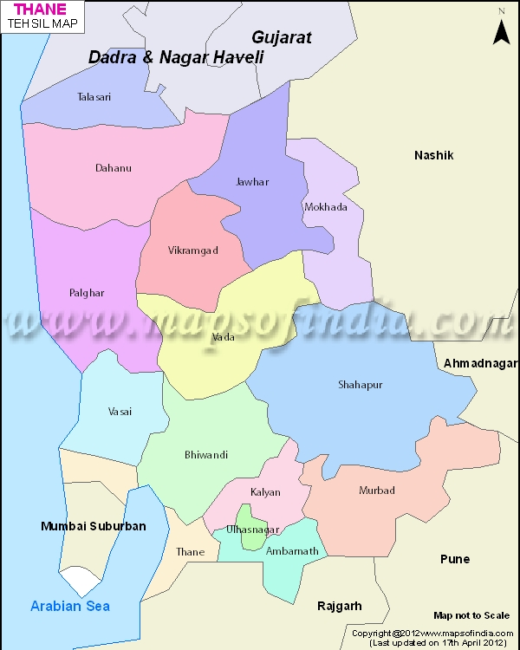
Our Reach in Thane Dist
Primary Eye Care Center established in Shahapur
Fully equipped and furnished Center
Cater its services to more than 3 lakhs of population
Eye Care Project with CSR of JSW coated Ltd & JSW holding ltd.
Permanent camp in Dahanu once in Month

Slide 12
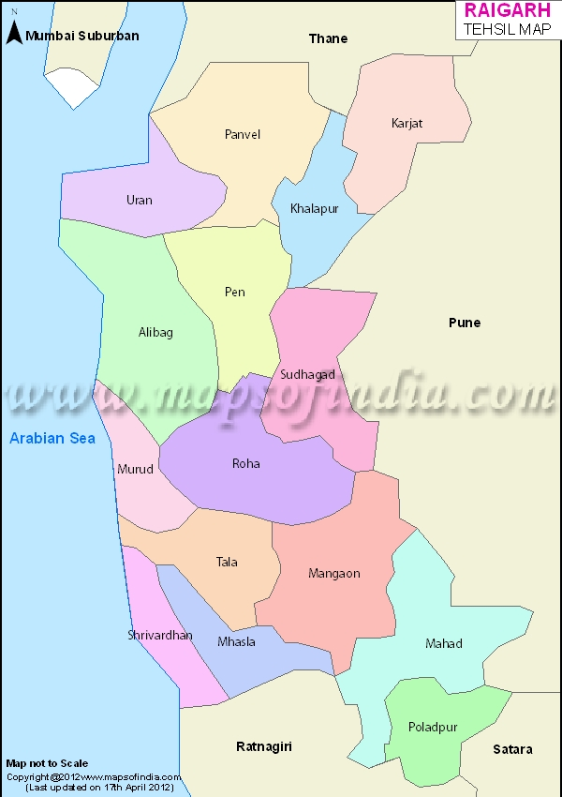
Our Reach in Raigad Dist
Primary Eye Care Center established in Alibaug, Karjat
In association with L. B. Rele Charitable Trust & Gramin Vikas Sanstha
This center caters its services to more than 4 lakhs of population
Alibaug Eye Care Project with CSR of Jasani Trust, Mumbai
Coming up Secondary Eye Hospital in New Panvel

Slide 13
Our Approach
Clinical Care –
Comprehensive eye care through KBHB Eye Hospital
Affordable and quality eye care at base hospital
Clinical human resource development including trainings and CMEs
Community Care –
Preventive and curative services provided
Awareness generation to the community
Organize eye camps / establish centers and mobile van activity
Human resource development
NGO Networking and referral system

Slide 14
Highlights (2011 – 2014)
No. of household screened / awareness created
923641
No. of patients examined & treated
369456 (40% of total screening)
No of patients provided surgical treatment
28410
No of patients received corrective glasses
Over 180 of personnel trained in eye health (Clinical and Social eye health)
Partnered with over 200 NGOs, CBOs, INGOs and CSRs

Slide 15
Why Partnership
Partnerships provides the capacity to achieve what may not otherwise be achieved. A partnership created by organization believing they can better achieve their goals by working together.
Sustainability – it will help hospital in building our own capacities in providing sustainable eye health services
Reach out – helps to reach more no of needy people from the targeted group / underserved area.
Learning Organization – Enables FOHS to learn from its partnership and improve models of service delivery
Power of 2 – we can achieve more working together than separately

Slide 16
General Partnership Models
Direct Project Funding –
Establish new vision center or adopt current center
Community outreach camps
School eye screening
Mobile Van camps
Support Cataract Surgeries
60% of total surgeries operated free of cost
Donate patients carrying bus
Support in drug bank
Support for food expenses of Free patients (5000 patients annually)
One time donation – Corpus fund
For any other please contact

Slide 17
Benefits of Partnership
Enhanced company & CSR profile
Greater community involvement
Employee engagement – Improved staff Morale
Positive Public Relation and Media Coverage
Networking opportunities
Tangible, life changing results

Slide 18
Relationship Management
One to one meeting with you
Understand your objectives and project finalization
Agree to outcomes, targets and budgets
Letter of agreement
Agree timeline of activity, provide timely reports on projects and funds utilization
Provide annual evaluation / project updates
Mention in annual report, website and other branding / communication material, branding the support, case studies (success stories)
Project visits to the site
Timely meetings

Slide 19
FOHS & KBHB : USP
FOHS is oldest organization which is working on eye health
Strong clinical presence in Mumbai & Maharashtra (KBHB Eye Hospital)
Comprehensive, quality, affordable and accessible eye care service provider in Mumbai and Maharashstra
Eye health programs in Urban, Rural and Tribal groups.
Excellent reach and strategy to reach very remote areas where there are no other significant intervention
More than 200 NGOs / CBOs having its firm grips in the communities
Committed professional staff with relevant subjects knowledge and experience

Slide 20
FOHS & KBHB : USP
Rigorous monitoring systems, evaluating the progress for
sustainable change
Technical expertise to various NGOs, and GOs in various aspects of eye health
Research collaboration with Hapkin Institute, TATA Memorial Hospital etc
Affiliations –
Member of National Program of Blindness Control
Member of VISION 2020 India
Awards / Recognition –
Samajratna award by Hariharputra Bhajan Samaj
Good Samaritan Awards by Wokhardt Foundation

Slide 21
Our Partners in Change
Jasani Trust

Slide 22
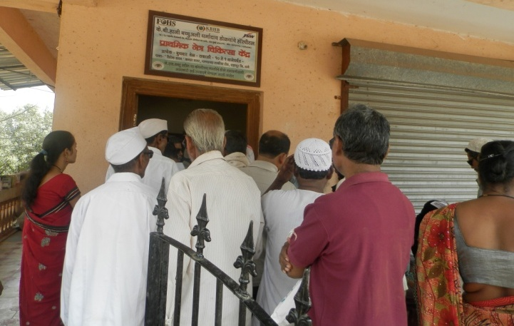
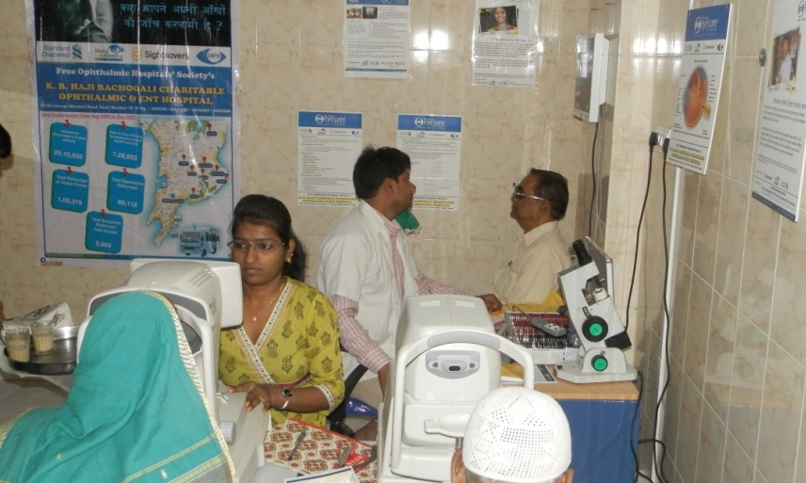
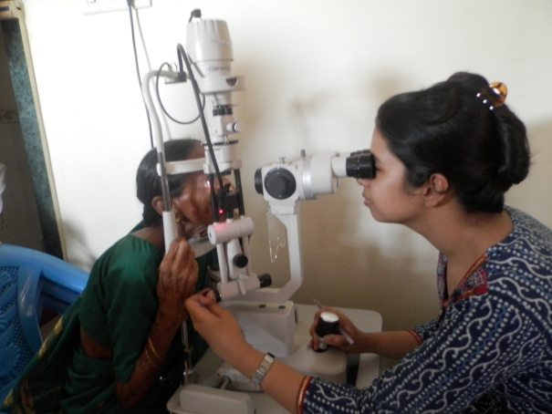
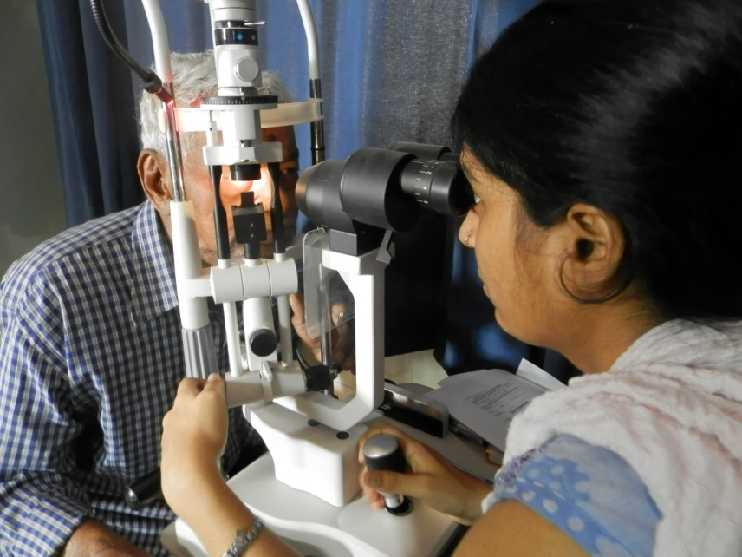
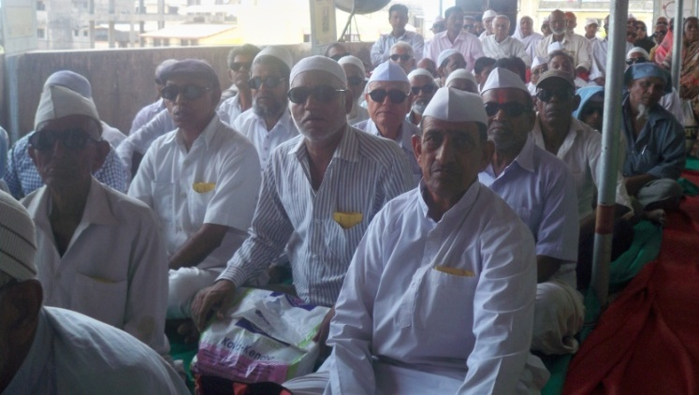
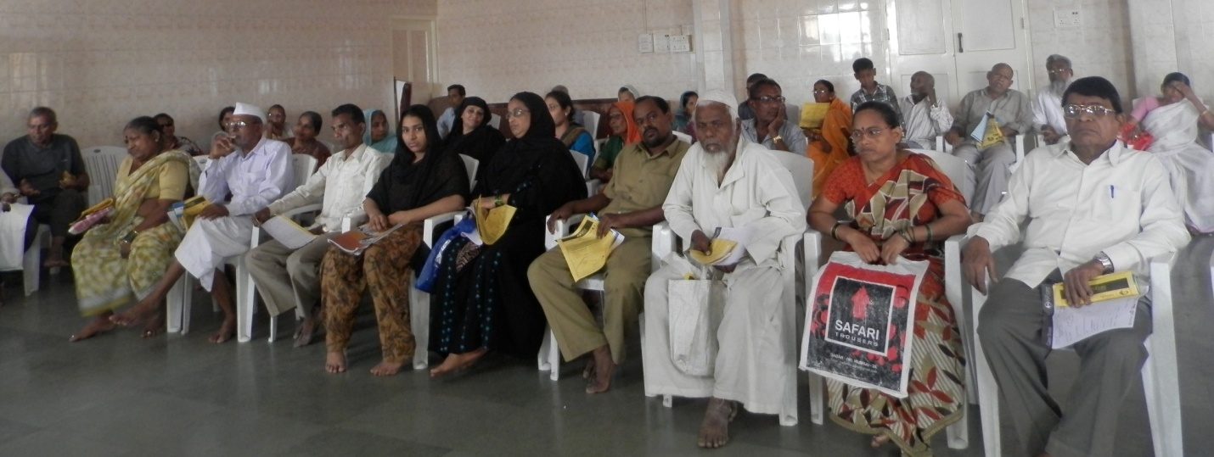
Glimpses
Primary Eye Care Center, Shahapur
Vision Center, Chembur

Slide 23
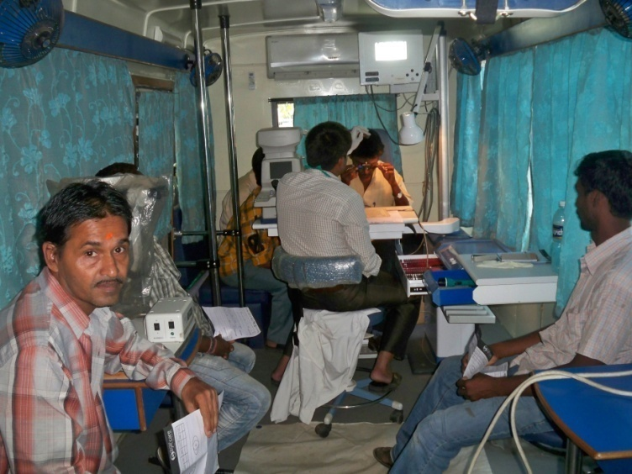
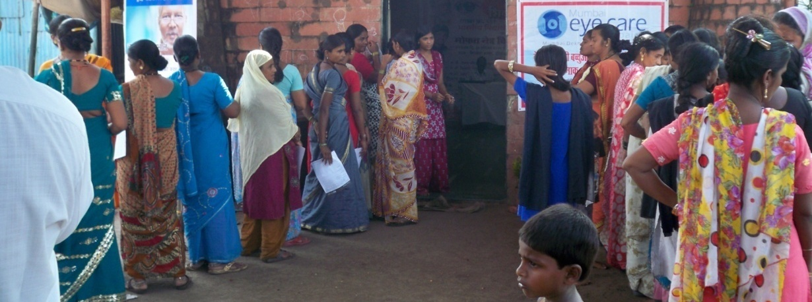
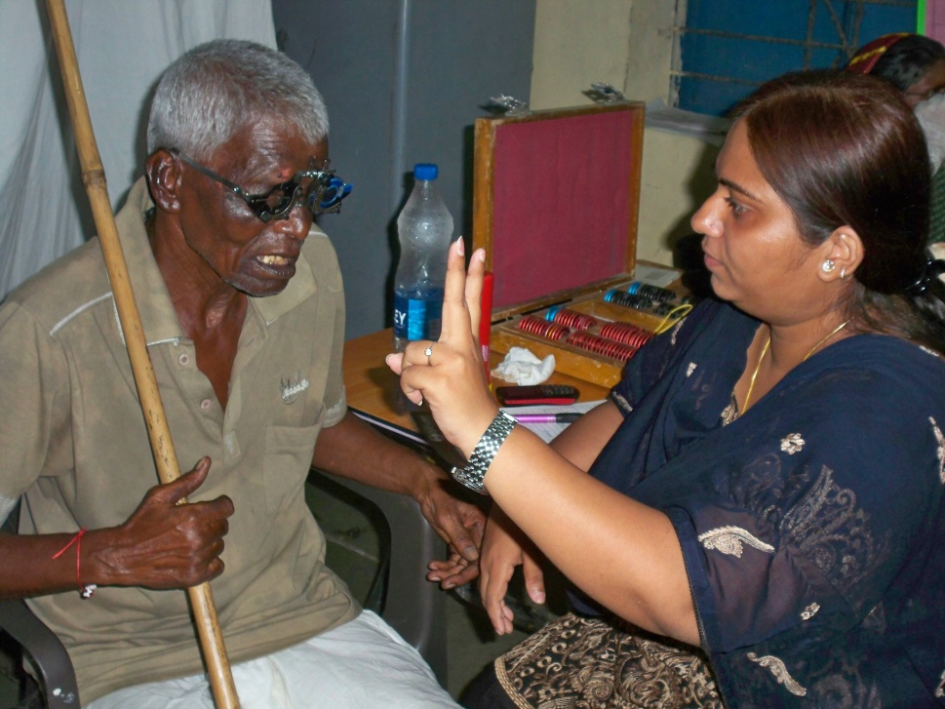
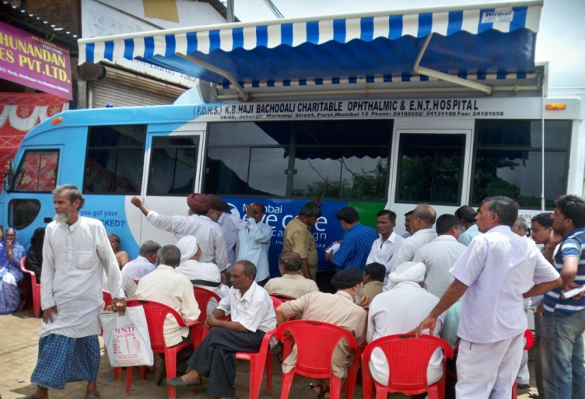
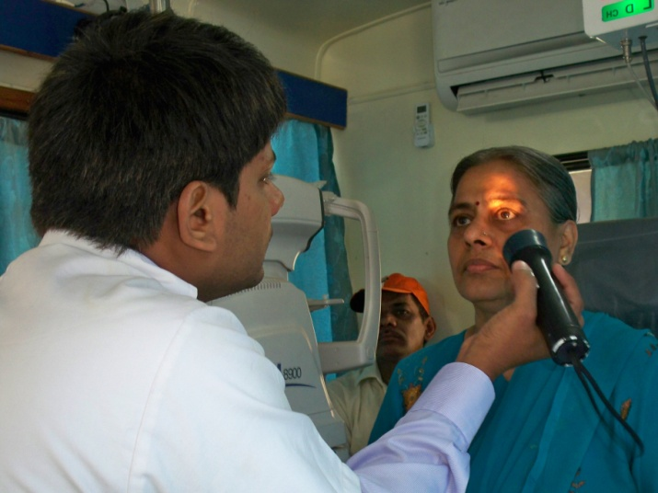
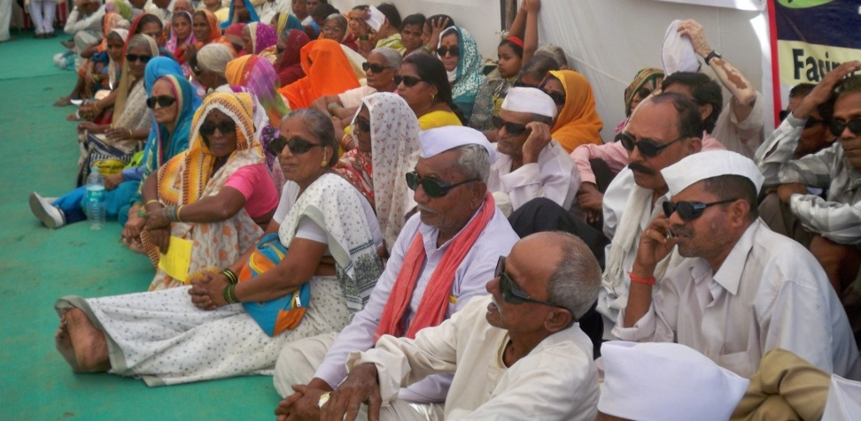
Glimpses
Fully Equipped Ophthalmic Mobile Van
Cataract Detection camps

Slide 24
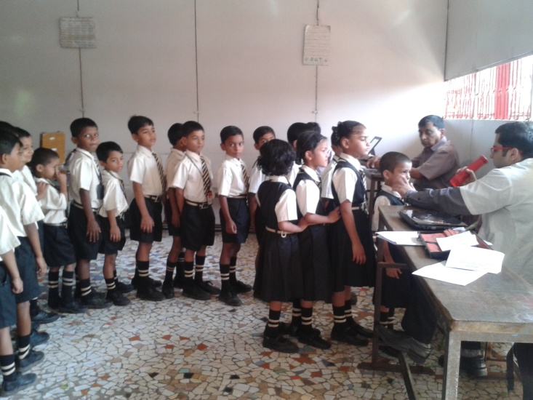
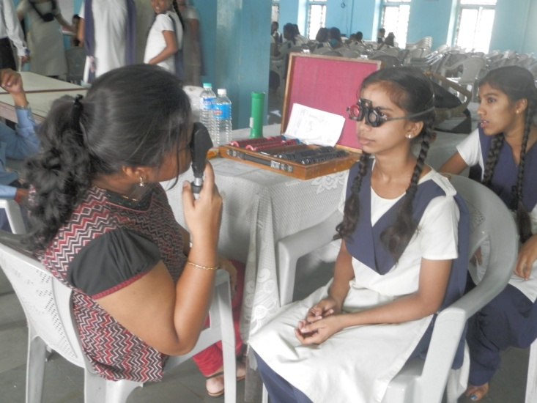
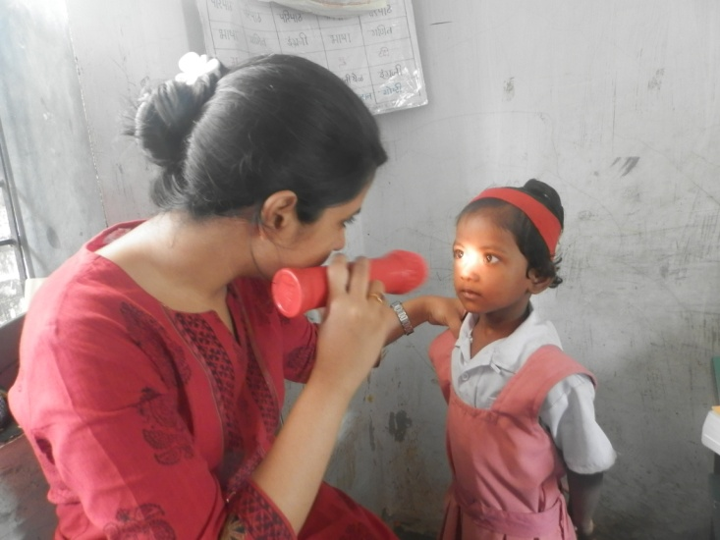
Retinopathy of Prematurity (ROP) Screening program – Premature babies
School Screening program

Slide 25
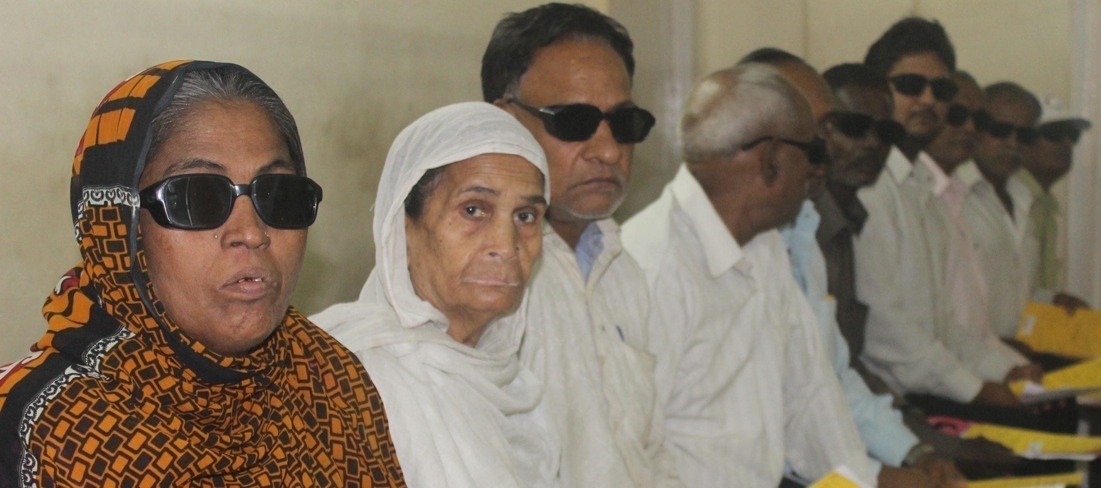
Contact :
Mr. Deepak Lalge
Manager - Programs & CSR Coordinator
+ 91 9819 870 807 / 7303 870 807
kbhb@rediffmail.com / fohs100@gmail.com

Slide 26
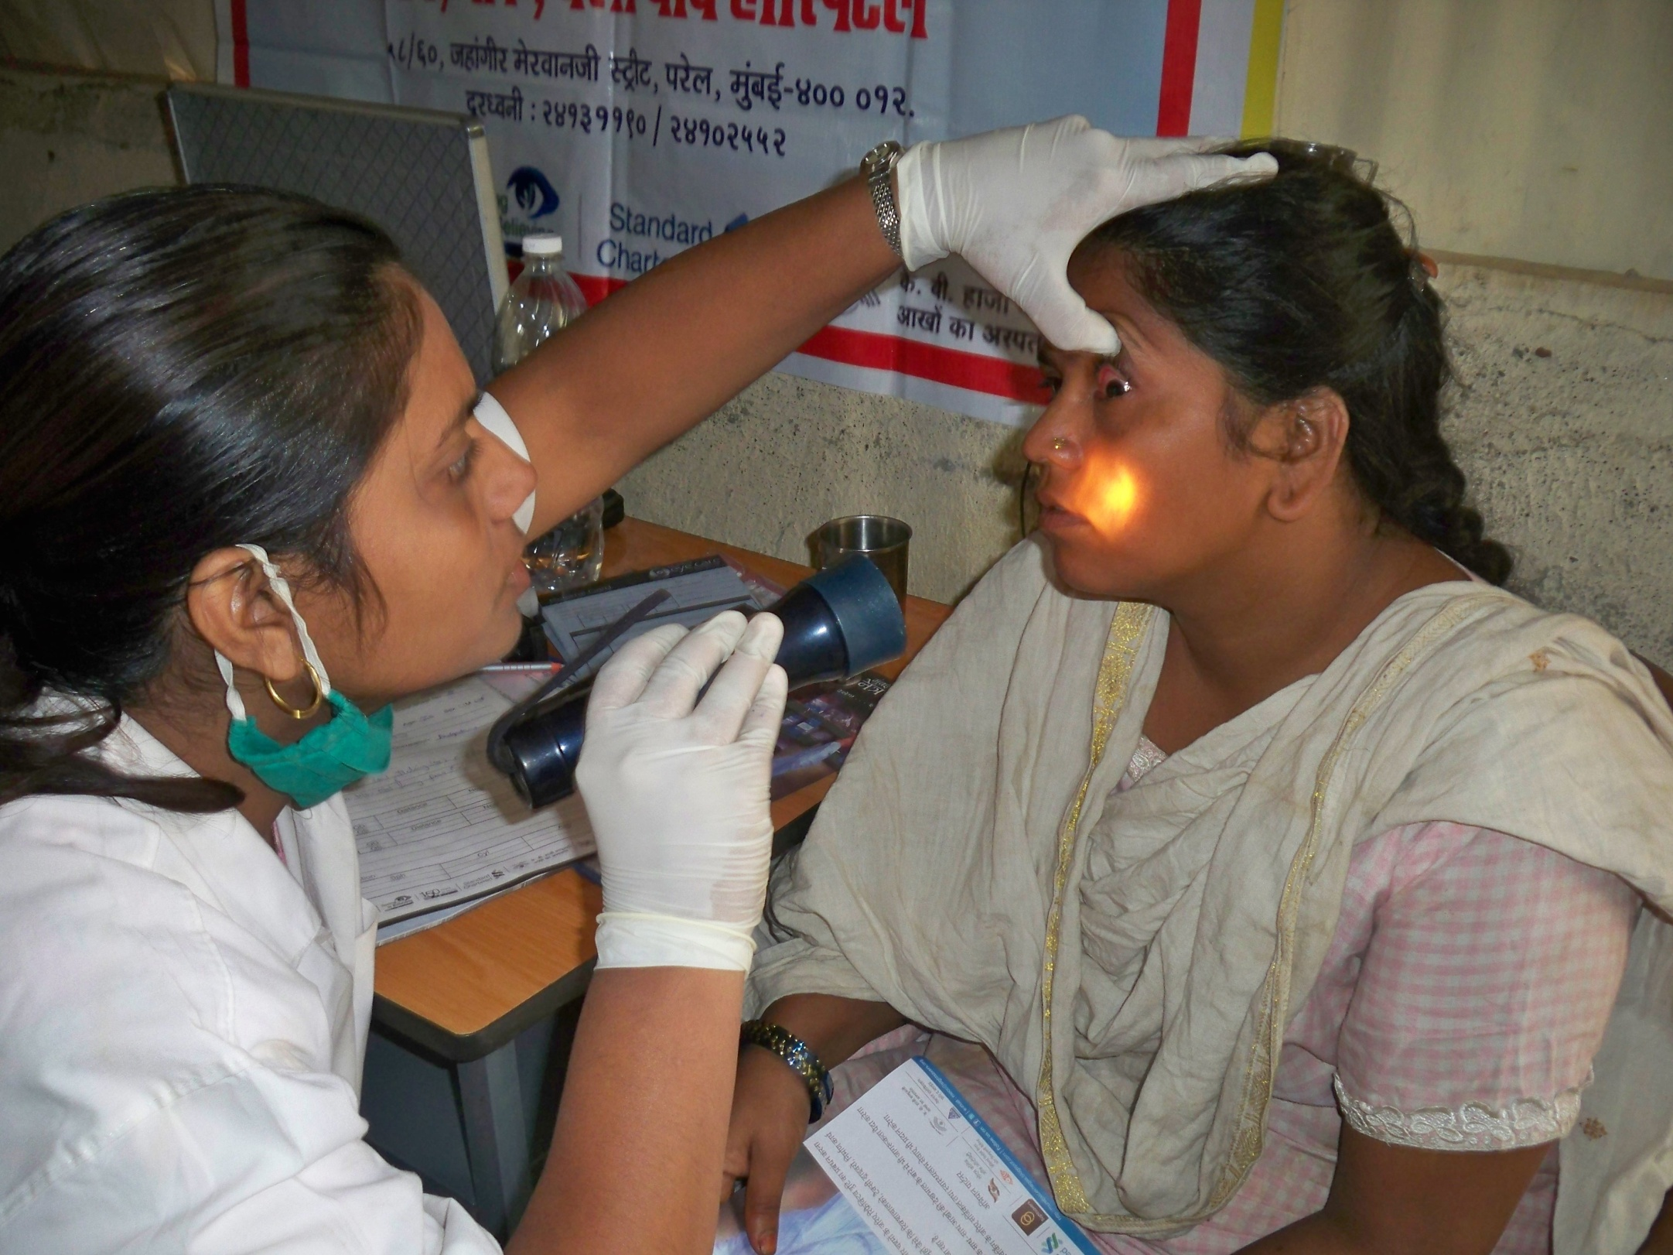
Thank You

